Slide 1

Web scraping to gain company insights
21/08/2023

Slide 2
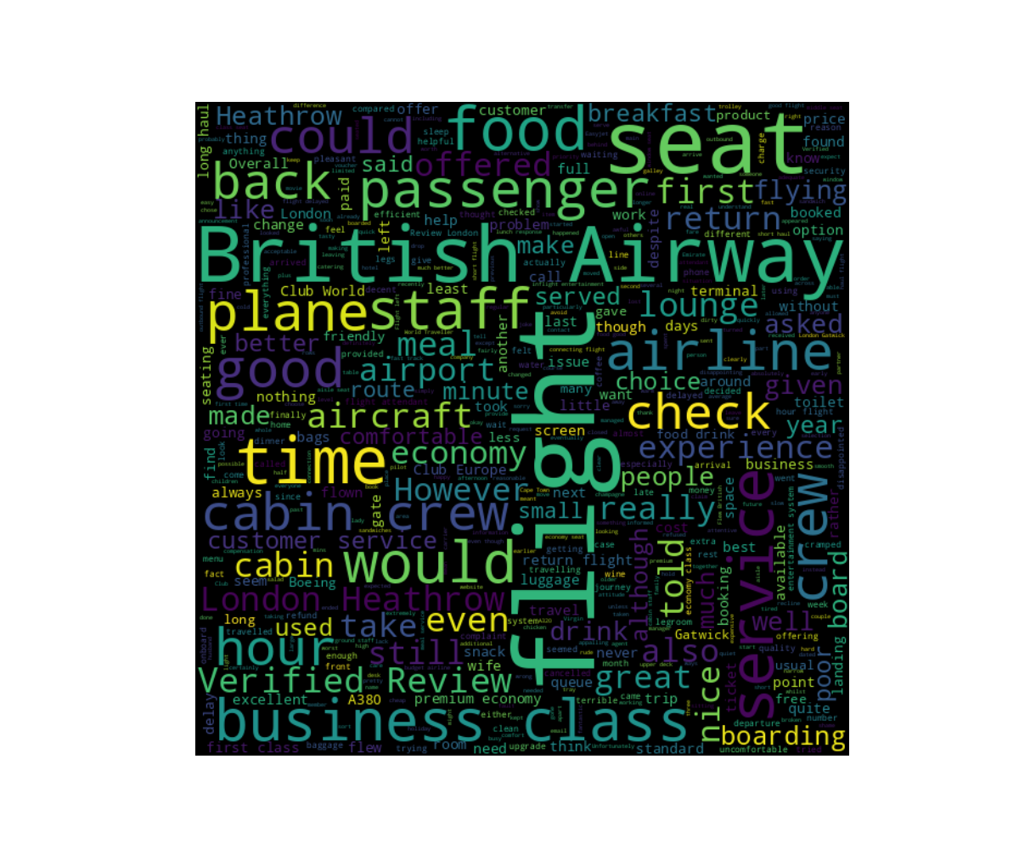
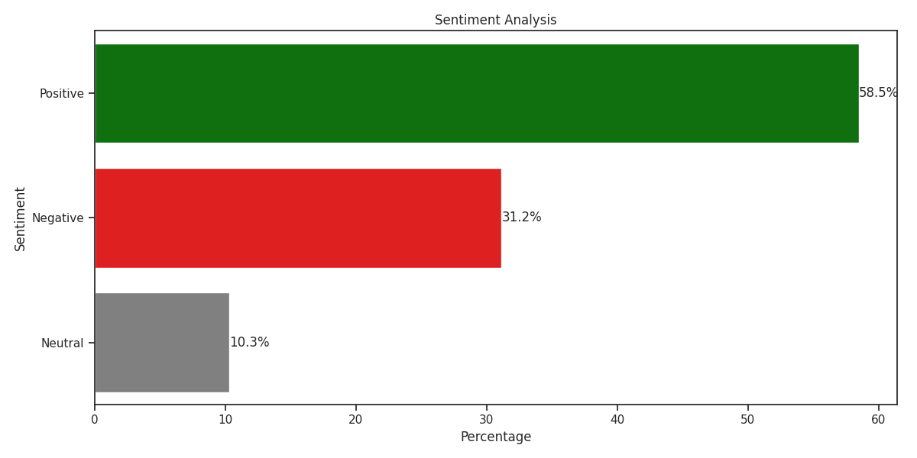
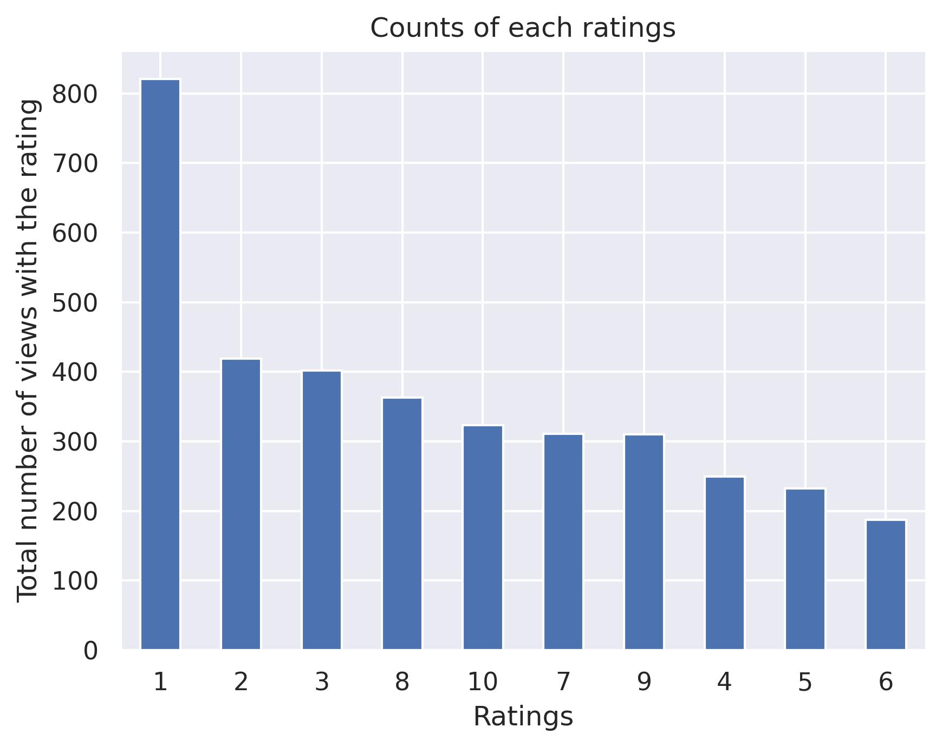
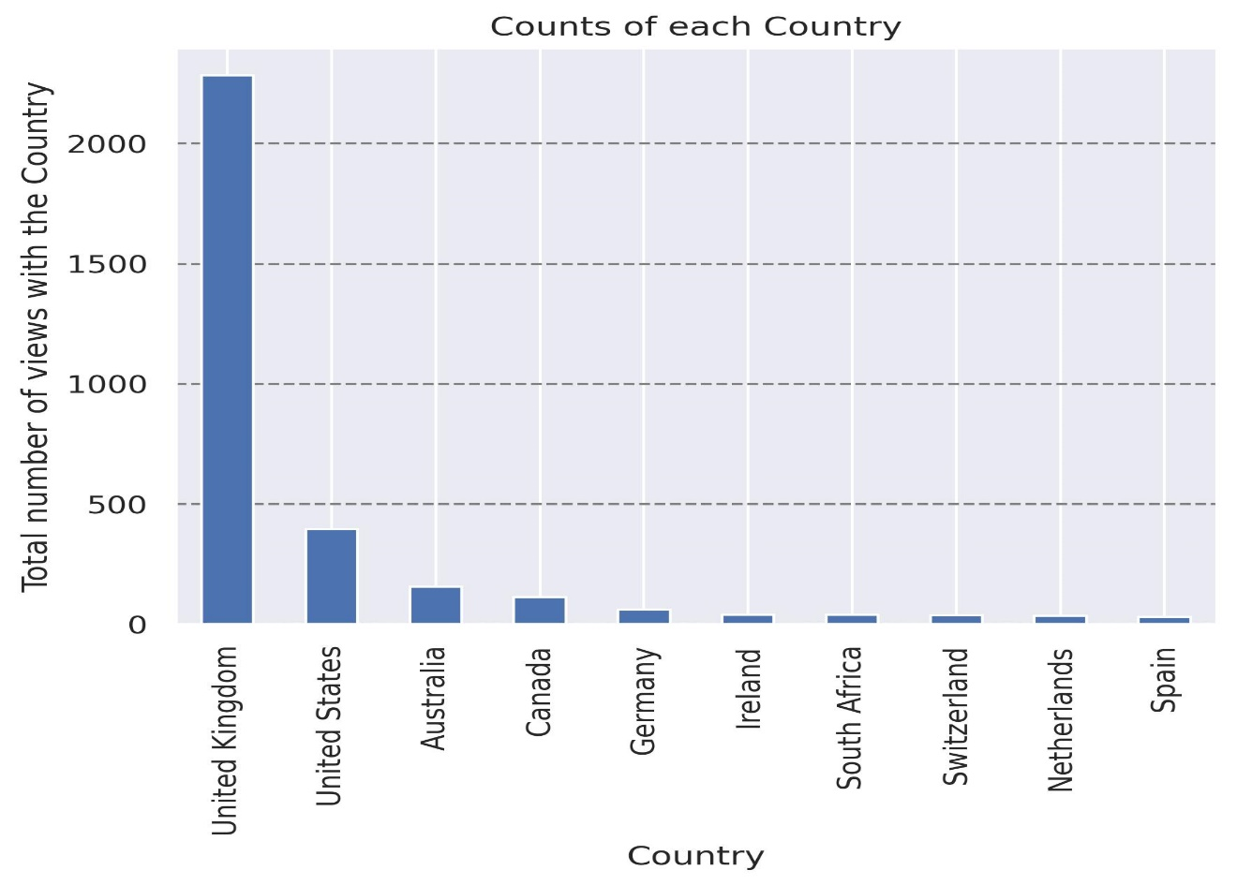
INSIGHTS FROM CUSTOMER REVIEWS
From cleaning 3619 reviews given by the customers, we obtained
Positive Reviews - 2116
Negative Reviews - 1127
Neutral Reviews – 374
Word cloud of keywords used in reviews

